Slide 1
Data Protection for Employment Lawyers
Aisling Byrne
Employment Lawyers Group NI
14 September 2022

Slide 2
Introduction
1
2
3
4
5
Current data protection regime in the UK
Key requirements
Data Subject Access Requests
Dealing with Data Breaches
Corporate Transactions

Slide 3
Current data protection regime
MAIN-42854449-1

Slide 4
Legislative Landscape
UK GDPR regime - two main pieces of legislation:
EU GDPR incorporated into UK law (Retained Regulation (EU) 2016/679) - UK GDPR
Parts of the Data Protection Act (DPA) 2018 relating to general personal data processing, powers of the IC, sanctions and enforcement
Both UK GDPR + DPA 2018 should be read together

Slide 5
Data Protection - Key terms
Personal Data
E.g. contact details, age, DOB, online identifier
Data relating to identified or identifiable individuals (data subject)
Data Controller
Determines the purpose(s) and the means of processing.
I.e. ‘why’ and ‘how’ data is processed.
Processing
E.g. collecting, organising, adapting, obtaining, recording, keeping, transferring or disclosing
Very widely defined
Special Category Data
E.g. data relating to health, genetics, biometrics, sex, race, religion, trade union membership, political opinion
Additional processing condition under Article 9 must be satisfied
Data Processor
Processes personal data on behalf of a data controller

Slide 6
Data Protection Principles
Lawfulness, fairness & transparency
Purpose Limitation
Data minimisation
Accuracy
Storage Limitation
Integrity & confidentiality
Accountability

Slide 7
Lawfulness - The Legal Basis of Processing
Consent
1
Performance of a contract
2
Compliance with a legal obligation
3
not always the best mechanism to legitimise processing - controllers should consider whether another ground is more appropriate
where processing is necessary for the performance of a contract or to take steps to enter into a contract
legal obligation must be laid down by UK law
Protect vital interests
4
5
6
Public interest
Legitimate interests
carrying out a specific task in the public interest which is laid down by law, or
exercising official authority
processing is necessary for the purposes of legitimate interests of the controller or a third party, except where such interests are overridden by the interests, rights or freedoms of the data subject
Where processing is necessary to protect someone’s life

Slide 8
How can employers lawfully process personal data?
Processing personal data
Processing special category data
Article 6, UK GDPR
Consent
Legal Obligation
Performance of a contract
Legitimate Interests
Article 9, UK GDPR
Explicit consent
Necessary for carrying out employment obligations
Necessary for substantial public interest reasons

Slide 9
Key obligations
MAIN-42854449-1

Slide 10
Data processing: roadmap to compliance
Identify personal data including any special category data
Decide on what lawful basis/ additional processing condition you will rely on.
Transparency: provide data subjects with information as to how their data will be used.
Consider if a data privacy impact assessment is needed
Process personal data (NB: processing is widely defined)
Record keeping:
Keep a record of processing activities (Art 30, UK GDPR)

Slide 11
What rights do data subjects have?
Right to restrict processing
Right of access
(SARs)
Data Subject Rights
Right to data portability
Right to erasure
Right to reject automated decision making

Slide 12
Right of Access under the DPA 2018 and UK GDPR
MAIN-42854449-1

Slide 13
How have Data Subject Access Rights changed?
Data Protection Act 1998
Section 7 DPA 1998 - data subject access rights
Subject access request had to be made in writing
Fee of £10 was payable
Controller could ask for evidence of identity
Comply “promptly” – at the latest within 40 days after receipt of the request

Slide 14
GDPR- Subject Access Rights - Article 15
The data subject shall have the right to obtain from the controller confirmation as to whether or not personal data concerning him or her are being processed, and, where that is the case, access to the personal data and the following information: (it may be set out in a privacy notice):
The purposes of the processing
The categories of personal data
The recipients or categories of recipient to whom personal data is disclosed
The retention period for storing the personal data or, where this is not possible, the criteria for determining how long you will store it
The existence of the data subject's right to request rectification, erasure or restriction or to object to such processing
The right to lodge a complaint with the ICO or another supervisory authority
Information about the source of the data, where it was not obtained directly from the individual
The existence of automated decision-making (including profiling)
The safeguards provided where personal data is transferred to a third country or international organisation.

Slide 15
Hidden Costs - 2020 Survey by Privacy Specialist Guardum
UK businesses are spending 24 person-years annually processing DSARs
DSARs cost £4,884.53 per request on average
DSARs take 66 working hours to process on average

Slide 16
How can a DSAR be made?
MAIN-42854449-1

Slide 17
Raising a DSAR?
DSARs – verbally, in writing, by video, using social media
You can ask for information to verify identity
Clock can be stopped until requested information received
ID documents should be requested promptly
Third party request - be satisfied that the third party making the request has authority

Slide 18
Timescale for response?
MAIN-42854449-1

Slide 19
Deadline
Compliance - without undue delay and within 1 month of receipt of the request
From the date of receipt to the corresponding date the following month
Time can be extended if:
the request is complex
a number of requests have been received from the data subjects
If extending time you must notify the data subject within one month and explain why

Slide 20
Third Party Information
MAIN-42854449-1

Slide 21
Information about other individuals?
You do not have to comply with a DSAR if doing so means disclosing information which identifies another individual except where:
The other individual has consented to the disclosure; or
It is reasonable to comply with the request without that individual’s consent, considering:
the type of information that you would disclose;
any duty of confidentiality owed to the third party;
any steps taken by you to try to get the third party’s consent;
whether the third-party individual is capable of giving consent; and
any stated refusal of consent by the third-party individual.

Slide 22
Exemptions
MAIN-42854449-1

Slide 23
GDPR exemptions - manifestly unfounded or excessive?
1
2
Manifestly unfounded
Excessive
Individual has no intention of exercising right of access.
Malicious motive to harass the organisation.
Intention is to cause disruption.
Unsubstantiated accusations made with malice.
Different DSARs sent regularly to cause disruption.
Request is clearly and obviously unreasonable taking into account the burden of costs involved and all the circumstances of the request:
Nature of requested information;
Context: relationship between requestor and organisation;
If refusal would cause individual substantial damage;
Available resources;
If request repeats previous requests;
Overlaps with other requests.
Options?
Refuse to respond to DSAR
Charge a reasonable fee
Extend response time for a further two months

Slide 24
What you should take into account when deciding if manifestly unfounded or excessive?
ICO Guidance
Consider each request individually –no blanket policy
Do not presume that a request is manifestly unfounded or excessive just because an individual has previously submitted a manifestly unfounded or excessive request
The inclusion of the word “manifestly” means - obvious or clear quality to unfoundedness/excessiveness
Ensure you have strong justifications for why you consider a request to be manifestly unfounded or excessive which you can demonstrate to the individual and the ICO

Slide 25
DPA 2018 Exemptions
DPA outlines additional exemptions which apply where data:
Is subject to legal or litigation privilege.
Is purely personal or for household activity.
Is a reference given (or to be given) in confidence for employment, training or educational purposes.
Is processed for the purposes of management forecasting or management planning in relation to a business or other activity to the extent that complying with a subject access request would prejudice the conduct of the business or activity.
Consists of records of intentions in relation to negotiations between the employer and employee to the extent that compliance with the subject access request would be likely to prejudice the negotiations.
Contains the personal data of a third party.
Is of the type which would be likely to prejudice the prevention or detection of crime, or the apprehension or prosecution of offenders if disclosed.

Slide 26
DSAR Lifecycle
Review DSAR and access information requested
Identify and locate personal data to be provided
DSAR
received
Provide response securely
Acknowledge receipt
Clarify scope of request with requestor of vague
Keep a record of DSAR and information provided
Consider if data needs redacted
Check requestor’s ID if any doubts

Slide 27
Top Tips
Scope
Review the scope
Consider how to search for relevant data
Ask for more detail to refine request
Manifestly unfounded / excessive?
Act quickly
One calendar month to respond (unless extended).
Substantial task.
Train staff to recognise SARs.
Be Prepared
Technology
Exemptions
Have clear, robust policies in place to cover SARs and data retention
Identify key stakeholders (IT, HR, Legal)
Consider how technology can assist your response to a SAR.
Not everything is relevant!
Legal privilege?
Manifestly excessive or unfounded?
Data created after DSAR?

Slide 28
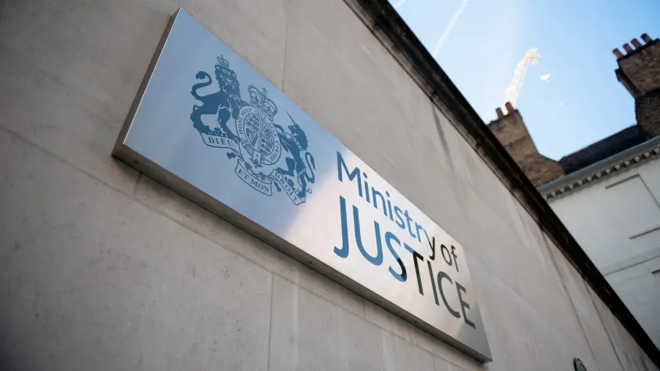
Recent Headlines
MOJ – March 2022 - Enforcement Action by the ICO – breach of Section 45 of the DPA 2018 and Article 15 of the UK GDPR
Failure to provide DSAR information to 7,753 data subjects unacceptable (25 had received no response and 7,728 had received only a partial response)
MOJ to remedy the situation by no later than 31 December 2022

Slide 29
Data Breaches
MAIN-42854449-1

Slide 30
Dealing with a data breach
Personal data breach
Mandatory notification to ICO
Timeframe
Records
Obliged to notify individuals
“Accidental or unlawful destruction, loss, alteration, unauthorised disclosure of, or access to, personal data…”
Unless breach is “unlikely to result in a risk” to the rights and freedoms of data subjects.
“Without undue delay” and in any event, within 72 hours.
Document data breaches, specifically the:
Facts;
Effect(s) of breach; and
Remedial action(s) taken.
If a data breach is “likely to result in a high risk” to the rights and freedoms of individuals.

Slide 31
Should we report a breach?
“If in doubt, the data controller should err on the side of caution and notify”.
- EU Guidelines
Consideration should be given to the following factors:
The type of breach;
The nature, sensitivity, and volume of personal data;
Ease of identification of individuals ;
Severity of consequences for individuals;
Special characteristics of individuals;
Special characteristics of the data controller; and
The number of affected individuals.

Slide 32
Data Breaches: Mitigating the risk
User-friendly policies
Regular training and updates for staff
Key steps
Clear reporting protocol
Robust security measures

Slide 33
ICO Fines 2020/2021
1
ICO fines increased by 1580% in 2020/2021
2
£42million in fines during financial year 2020/2021

Slide 34
ICO fines
Mermaids – UK charity offers support to gender diverse children, young people and their families
CEO set up an internet email group in 2016 to exchange emails with 12 Trustees
Default security settings for the group – publicly viewable messages
2019 – mother contacted by Sunday Times journalist who, via a search engine, found confidential emails including telephone number, information relating to her child’s mental and physical health.
550 data subjects, 4 of whom were children, information was special category data in the case of 15 data subjects
ICO issued a fine in July 2021 - £25,000 - 2.8% of the charity’s annual turnover.

Slide 35
ICO fines
HIV Scotland – email to 105 people, blind copy function was not used, 65 of the addresses identified people by name
Human error
An assumption could be made about the email recipients HIV status or risk
ICO found - Staff training was inadequate, no employee data protection policy outlining what was expected of staff
ICO issued a fine of £10,000 in October 2021

Slide 36
Corporate Transactions
MAIN-42854449-1

Slide 37
Data Sharing in Corporate Transactions
Timing will dictate the lawful basis
Consider the type of transaction –
Share sale – more difficult, TUPE will not apply, may be able to rely on legitimate interests as a lawful basis for processing
Asset sale – where TUPE applies ELI will be furnished, legal obligation basis for processing, for information in addition to ELI consider legitimate interests basis
Consider anonymisation
Think about accountability – ensure that the personal data is safe, secure, only process information that you actually need

